Slide 1

Pattern Recognition
Perceptron Learning Algorithm and Neural Networks
Chumphol Bunkhumpornpat
Department of Computer Science
Faculty of Science
Chiang Mai University

Slide 2
Learning Objectives
Learn how to classify patterns using a linear decision boundary
Understand the intricacies of the perceptron learning algorithm and how it is used to learn weight vectors

Slide 3
Learning Objectives (cont.)
Discover neural networks and how they were evolved from studying the human brain
Know what is meant by support vector machines

Slide 4
SVM: Support Vector Machine
Binary Classifier
Decision Boundary in Multi-Dimensional Space
  Support vectors are those training patterns that are closest to the decision boundary.
Linear Discriminant Functions
  They discriminate between patterns.

Slide 5
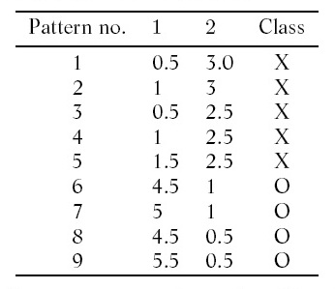
Description of the Patterns

Slide 6
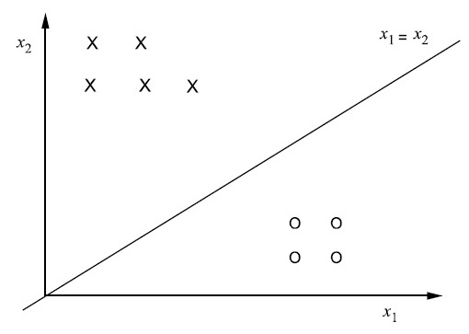
Classification Using a Linear Discriminant Function

Slide 7
Classification Using a Linear Discriminant Function (cont.)
Linearly Separable
  x₁ = x₂ : Separating Between 2 Classes
One More Way
  x₁ < x₂ OR x₁ – x₂ < 0 : Negative Side : Class X
  x₁ > x₂ OR x₁ – x₂ > 0 : Positive Side : Class O
Pattern 1: Class X
  0.5 – 3 = –2.5 < 0
Pattern 9: Class O
  5.5 – 0.5 = 5 > 0

Slide 8
Classification Using a Linear Discriminant Function (cont.)
Possibly Finite Way: x₁ – x₂ = 1
  x₁ – x₂ < 1 : Negative Half Space : Class X
  x₁ – x₂ > 1 : Positive Half Space : Class O
x₁ – x₂ = 0 and x₁ – x₂ = 1 are parallel.
  x₁ – x₂ = 0 passes through the origin.
  x₁ – x₂ = 1 provides more for class X.
Another Line: 3x₁ – 2x₂ = 0

Slide 9
Classification Using a Linear Discriminant Function (cont.)
Functional Form: f(x) = w₁x₁ + w₂x₂ + b = 0
Hyper-Plane: f(x) = w^{t}x + b = 0
  w^{t}, x : d-Dimensional Space Vector
  b: Scalar
  Homogeneous Form: b = 0
  Non-Homogeneous Form: b ≠ 0
X and O are linearly separable if we can find
  w^{t}x + b > 0 for O
  w^{t}x + b < 0 for X

Slide 10
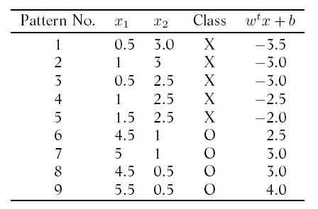
Linearly Separable Classes

Slide 11
Linearly Separable Classes (cont.)
w^{t} = (1, –1)
b = –1
Non-Homo : x₁ – x₂ – 1 = 0
O : Positive
  w^{t}x + b > 0
X : Negative
  w^{t}x + b < 0

Slide 12
Mapping a Boundary Decision in a Homogeneous Form
Transformation from a d-dimensional space
to a (d+1)-dimensional space
Adding 1 as the d+1th Component
  x_{d+1} = 1
  w_{d+1} = b
f(x’) = z^{t}x′
  z^{t} = (w^{t}, b)
  x′ = (x, 1)

Slide 13
Mapping a Boundary Decision in a Homogeneous Form (cont.)
Non-Homo : x₁ – x₂ – 1 = 0
Homo : z^{t}x′ = 0
  z^{t} = (1, – 1, –1)
  x′ = (x₁, x₂, 1)
We will use w^{t} and x instead of z^{t} and x′.

Slide 14
Normalisation
All the patterns lie on the positive side of the line.
This is achieved by replacing every feature value of each pattern from class X by its negation including the d+1th entry

Slide 15
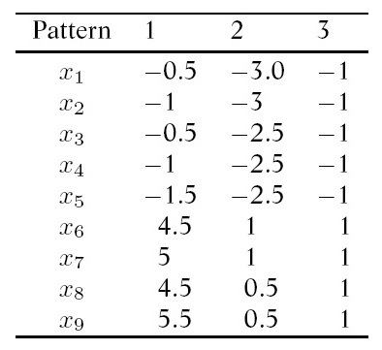
Description of
Normalised 3-Dimensional Patterns

Slide 16
Perceptron Learning Algorithm
STEP 1: Initialise w as the null vector.
In other words, set i = 1 and w^{t}_{i} = 0.
STEP 2: For j = 1 to n do
If w^{t}_{i}x_{j} ≤ 0 then i = i + 1 and w^{t}_{i} = w^{t}_{i–1} + x_{j}
STEP 3: Repeat step 2 till the value of i does not change during an entire iteration over all the n patterns.

Slide 17
Working of the Algorithm
w^{t}₁ = (0, 0, 0) and x^{t}₁ = (–0.5, –3, –1)
w^{t}₁x₁ = 0; w^{t}₂ = w^{t}₁ + x₁ = (–0.5, –3, –1)
w^{t}₂x₂ = 10.5 (> 0), w^{t}₂x₃ = 8.75, w^{t}₂x₄ = 9,
w^{t}₂x₅ = 9.25
These patterns are properly classified by w^{t}₂ and do not affect the weight vector.
w^{t}₂x₆ = –6.25 (< 0); w^{t}₃ = w^{t}₂ + x₆ = (4, –2, 0)

Slide 18
Working of the Algorithm (cont.)
w₃ classifies x₇, x₈, x₉ and in the next iteration
x₁, x₂, x₃, and x₄ correctly.
w^{t}₃x₇, w^{t}₃x₈, w^{t}₃x₉, w^{t}₃x₁, w^{t}₃x₂, w^{t}₃x₃, w^{t}₃x₄ > 0
w^{t}₃x₅ = –1 (< 0); w^{t}₄ = w^{t}₃ + x₅ = (2.5, –4.5, –1)
w^{t}₄ classifies x₆, x₇, x₈, x₉, x₁, x₂, x₃, x₄, and x₅ correctly so w^{t}₄ is the desired vector.
2.5x₁ – 4.5x₂ – 1 = 0
5x₁ – 9x₂ – 2 = 0

Slide 19
Multi-Class Problems
Suppose we have 3 classes: X, O, and *.
To consider a pair of classes at a time,
a majority of the decisions are in favour of assigning patterns (w_{XO}, w_{X*}, and w_{O*}).
To consider two-class problems; C_{i} and C′_{i} where C′_{i} = ∪^{C}_{j=1;j≠1}C_{j}, learning a linear discriminant function to classify each of these problems (w_{X}, w_{O}, and w*).

Slide 20
Neural Networks
Neuron
  communicates with other neurons
Electrochemical Signal
  received by neurons
Synapse
  combines signals
Axon
  sends out an output

Slide 21
Neural Networks (cont.)
It starts by taking random weights.
If the output is correct, then nothing is done to the weights in the network.
If the output is wrong, the error is calculated and it is used to update all the weights in the work.

Slide 22
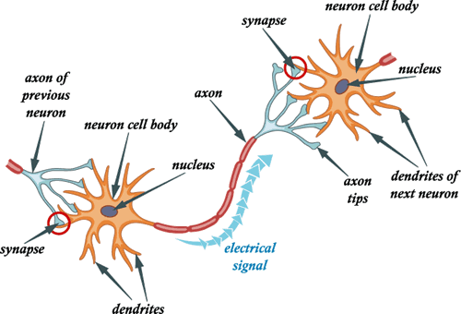
Human Brain

Slide 23
Artificial Neuron
The input to the neuron is weighted and summed up and if this aggregate exceeds a threshold, the neuron outputs a signal.
Inputs : x₁, x₂, …, x_{n}
Weights : w₁, w₂, …, w_{n}
Activation : a = w₁x₁ + w₂x₂ + … + w_{n}x_{n}
Output : o
Threshold : t

Slide 24
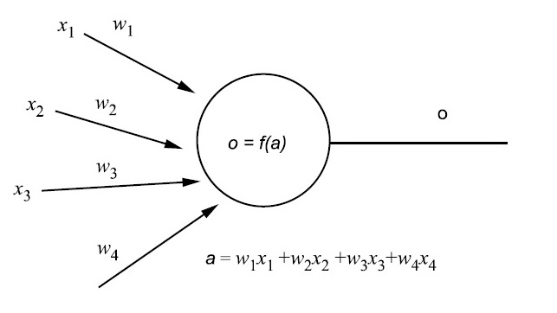
Patterns Represented in Feature Space

Slide 25
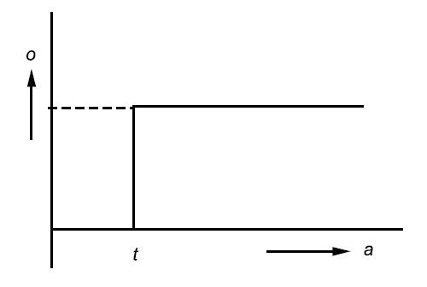
Threshold Activation Function

Slide 26
Threshold Activation Function (cont.)
o = 1 if a ≥ t
o = 0 if a < t
a = w₁x₁ + w₂x₂ = 5x₁ – 9x₂
t = 2
O : a > 2 (o = 1)
X : a < 2 (o = 0)

Slide 27
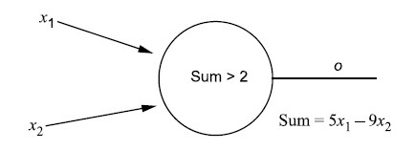
Perceptron for 5x₁ – 9x₂ = 2

Slide 28
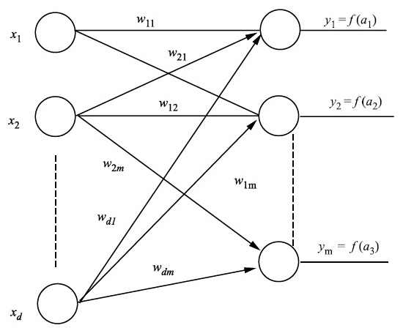
Feed-Forward Network

Slide 29
Feed-Forward Network (cont.)
Linear Decision Boundary
The number of input nodes : d
The number of output nodes : m
5x₁ – 9x₂ = 2
  d = 2
  m = 1
  w₁₁ = 5
  w₂₁ = –9
  t = 2

Slide 30
Feed-Forward Network (cont.)
The activation at the output unit i (1 ≤ i ≤ m)
  a_{i} = w_{1i}x₁ + w_{2i}x₂ + … + w_{di}x_{d}
The correct output at the i^{th} output node : t_{i}
The output at the i^{th} output node : o_{i} = f(a_{i})
The error at the i^{th} output node : e_{i} = t_{i} – o_{i}
  Back-Propagation : Updating the weights
  Minimise
The updated weight between the j^{th} input node and the i^{th} output node
  w_{ji} = w_{ji} + α × x_{j} × e_{j}

Slide 31
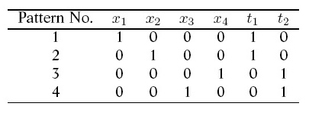
Four-dimensional data with two output units

Slide 32
Initialization
d = 4
m = 2
w_{ji} = 0.5 for 1 ≤ j ≤ 4 and i = 1, 2
t = 0
α = 0.5

Slide 33
Pattern No. 1
a₁ = 0.5×1 + 0.5×0 + 0.5×0 + 0.5×0 = 0.5 > 0
a₂ = 0.5×1 + 0.5×0 + 0.5×0 + 0.5×0 = 0.5 > 0
a₁ > t so o₁ = 1 and then e₁ = t₁ – o₁ = 1 – 1 = 0
a₂ > t so o₂ = 1 and then e₂ = t₂ – o₂ = 0 – 1 = -1

Slide 34
Pattern No. 1 (cont.)
  w_{NEW} = w_{OLD} + α × x × e₁
w₁₁ = 0.5 + 0.5 × 1 × 0 = 0.5
w₂₁ = 0.5 + 0.5 × 0 × 0 = 0.5
w₃₁ = 0.5 + 0.5 × 0 × 0 = 0.5
w₄₁ = 0.5 + 0.5 × 0 × 0 = 0.5

Slide 35
Pattern No. 1 (cont.)
  w_{NEW} = w_{OLD} + α × x × e₂
w₁₂ = 0.5 + 0.5 × 1 × (-1) = 0.0 *change
w₂₂ = 0.5 + 0.5 × 0 × (-1) = 0.5
w₃₂ = 0.5 + 0.5 × 0 × (-1) = 0.5
w₄₂ = 0.5 + 0.5 × 0 × (-1) = 0.5

Slide 36
Pattern No. 2
Change จากรอบก่อน
a₁ = 0.5×0 + 0.5×1 + 0.5×0 + 0.5×0 = 0.5 > 0
a₂ = 0.0×0 + 0.5×1 + 0.5×0 + 0.5×0 = 0.5 > 0
a₁ > t so o₁ = 1 and then e₁ = t₁ – o₁ = 1 – 1 = 0
a₂ > t so o₂ = 1 and then e₂ = t₂ – o₂ = 0 – 1 = -1

Slide 37
Pattern No. 2 (cont.)
  w_{NEW} = w_{OLD} + α × x × e₁
w₁₁ = 0.5 + 0.5 × 0 × 0 = 0.5
w₂₁ = 0.5 + 0.5 × 1 × 0 = 0.5
w₃₁ = 0.5 + 0.5 × 0 × 0 = 0.5
w₄₁ = 0.5 + 0.5 × 0 × 0 = 0.5

Slide 38
Pattern No. 2 (cont.)
  w_{NEW} = w_{OLD} + α × x × e₂
w₁₂ = 0.0 + 0.5 × 0 × (-1) = 0.0
w₂₂ = 0.5 + 0.5 × 1 × (-1) = 0.0
w₃₂ = 0.5 + 0.5 × 0 × (-1) = 0.5
w₄₂ = 0.5 + 0.5 × 0 × (-1) = 0.5

Slide 39
Patterns No. 1, 2, 3 and 4
e₁ = e₂ = 0 STOP
All the four patterns are correctly classified.
Weights are not changed for each of the four patterns.

Slide 40
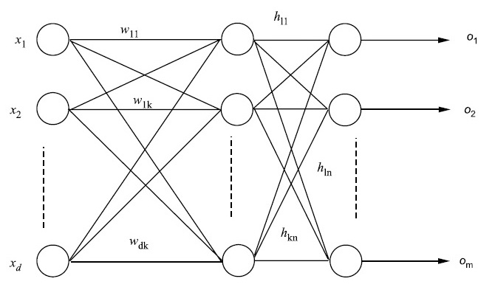
Multilayer Perceptron with a Hidden Layer

Slide 41
Multilayer Perceptron with a Hidden Layer (cont.)
Non-Linear Decision Boundary
The weights from the input layer to the hidden layer : w₁₁, w₁₂, …, w₂₁, w₂₂, …, w_{dk}
The weights from the hidden layer to the output layer : h₁₁, h₁₂, …, h_{km}
The output of the j^{th} hidden node : o_{hj} = f(a_{j})
Activation of the hidden unit j (1 < j < k)
  a_{hj} = x₁ × w_{1j} + x₂ × w_{2j} + … + x_{m} × w_{mj}
Activation of the output node l
  a₁ = oh₁ × h₁₁ + oh₂ × h₂₁ + … + oh_{k} × h_{k1}
The updated weight between hidden and output units
  h_{ji} = h_{ji} + α × o_{j} ×e_{i} × g′(a_{i})

Slide 42
SVM for Classification
Support Lines
  x₁ – x₂ = 0 : Points from X satisfies x₁ – x₂ < 0.
  x₁ – x₂ = 2 : Points from O satisfies x₁ – x₂ > 2.
Support Vectors
  X : (1, 1)^{t} and (2, 2)^{t}
  O : (2, 0)^{t}
Margin: Region between the two lines

Slide 43
SVM for Classification (cont.)
SVM learns the linear discriminant of the form
w^{t} + b that maximises the margin.
  w : the weight vector
  b : the threshold value.
x₁ – x₂ = 1
  X : x₁ – x₂ < 1
  O : x₁ – x₂ > 1

Slide 44
SVM for Classification (cont.)
Decision Boundary
  d-Dimensional Space (d > 2) : Support Planes
  Two-Dimensional Space (d = 2) : Support Lines

Slide 45
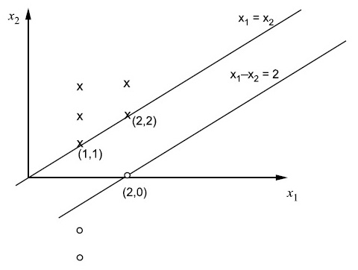
Illustration of
Support Vector Machines

Slide 46
Reference
Murty, M. N., Devi, V. S.: Pattern Recognition: An Algorithmic Approach (Undergraduate Topics in Computer Science). Springer (2012)

